Slide 1
Bothoven at work – Feedback from actual musicians
By john Halloran and Jason arnold

Slide 2

The latest prototype

Slide 3
Interactions

Slide 4
Jessica - Vocalist
What Worked Rhythmic fashion was visible Could easily follow rhythm and understand location in music Visual metronome replacement Playing/following along made sense Looks really cool | What could be improved Motion somewhat clunky Improve mobility/fluidity Make more human Clearer beats Larger/wider hand motions Stability of robot
Questions Will this actually replace a conductor? | Ideas Be able to save/send recording

Slide 5
Megan - Percussion
What Worked Made a lot of sense The beginning explanation was beneficial (120 beats/minute, etc.) Looks awesome | What could be improved First prep beat not exactly clear Wants more prep info
Questions Can we get more information at the beginning? | Ideas Louder/improved metronome Longer improvisation time

Slide 6
Cristina – Violinist
What Worked Looks cool The idea is really great | What could be improved Doesn't work well with classical music Classical musician focused on notes & fluidity BOThoven solely focused on rhythm Worried won't know how to follow at the beginning
Questions Can we improve audio feeback? | Ideas Emphasize downbeat Use an actual piece Possibly play piece along with musician?

Slide 7
John - GUITARIST
What Worked Stayed on beat Movement = fluid enough Loves audio playback idea Believes best way to learn is to hear own feedback | What could be improved Shakes/wobbles More precise movements Robotic movement dominates recording Include audio metronome
Questions Improve the audio feedback? Better musician's assistant for casual players? | Ideas Robotic legs = unnecessary Could remove for stability Improve audio feedback = microphone for musician?

Slide 8
OVERALL
What Worked Intuitive and made sense Rhythmic capabilities Prep info = beneficial (want more!) Audio feedback = great idea | What could be improved Improve stability of BOThoven Reduce background noise for audial feedback Louder/more integreated audial metronome Emphasize prep beat and prep info more
Questions Improve the audio feedback? Actually replace a conductor? | Ideas Be able to save/send recording Integrate an actual musical piece Emphasize downbeat more Remove legs

Slide 9
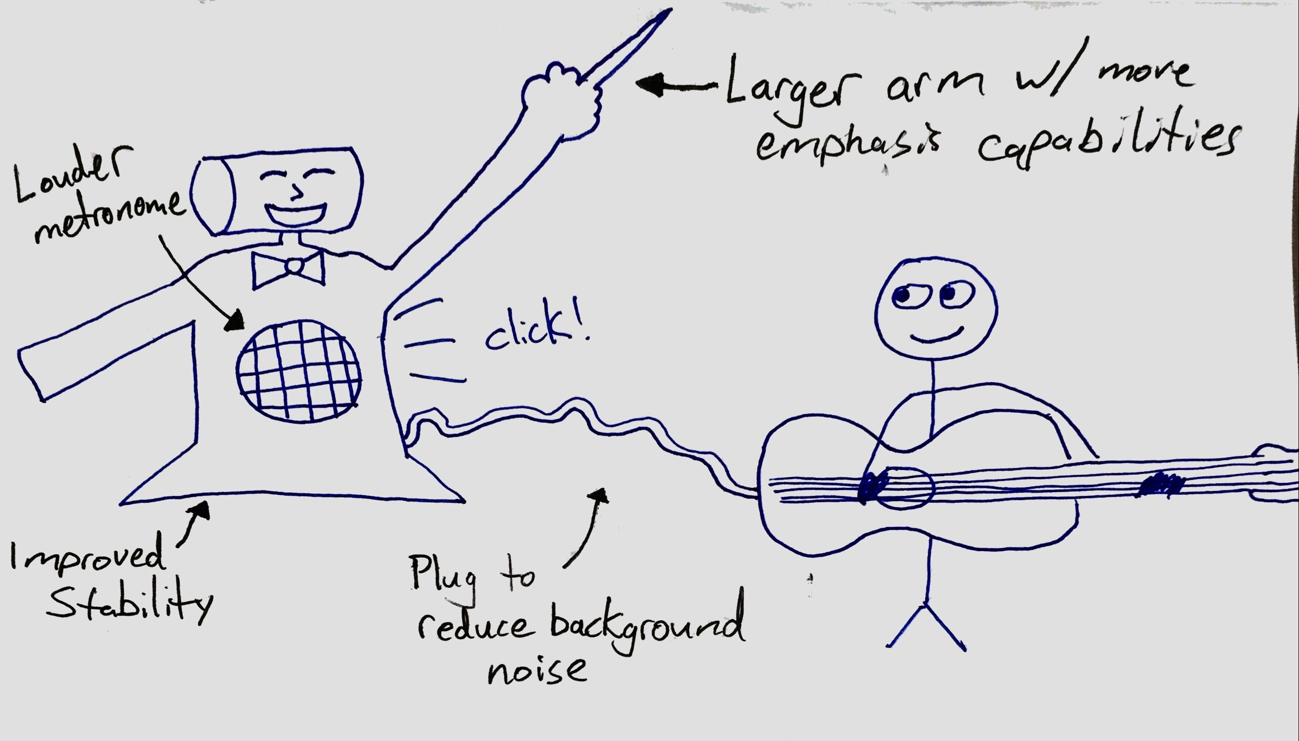
Newer Functionality

Slide 10

Thank you!
Questions?

